Slide 1
China STM Focus
——One Stop Access Platform for English Academic Resources in China
http://cstm.cnki.net/

Slide 2
Outline
——China STM Focus
1.Introduction
2.Advantages
3.Main Functions
PPT模板下载：www.1ppt.com/moban/ 行业PPT模板：www.1ppt.com/hangye/
节日PPT模板：www.1ppt.com/jieri/ PPT素材下载：www.1ppt.com/sucai/
PPT背景图片：www.1ppt.com/beijing/ PPT图表下载：www.1ppt.com/tubiao/
优秀PPT下载：www.1ppt.com/xiazai/ PPT教程： www.1ppt.com/powerpoint/
Word教程： www.1ppt.com/word/ Excel教程：www.1ppt.com/excel/
资料下载：www.1ppt.com/ziliao/ PPT课件下载：www.1ppt.com/kejian/
范文下载：www.1ppt.com/fanwen/ 试卷下载：www.1ppt.com/shiti/
教案下载：www.1ppt.com/jiaoan/
4.Service Mode
PPT模板下载：www.1ppt.com/moban/ 行业PPT模板：www.1ppt.com/hangye/
节日PPT模板：www.1ppt.com/jieri/ PPT素材下载：www.1ppt.com/sucai/
PPT背景图片：www.1ppt.com/beijing/ PPT图表下载：www.1ppt.com/tubiao/
优秀PPT下载：www.1ppt.com/xiazai/ PPT教程： www.1ppt.com/powerpoint/
Word教程： www.1ppt.com/word/ Excel教程：www.1ppt.com/excel/
资料下载：www.1ppt.com/ziliao/ PPT课件下载：www.1ppt.com/kejian/
范文下载：www.1ppt.com/fanwen/ 试卷下载：www.1ppt.com/shiti/
教案下载：www.1ppt.com/jiaoan/

Slide 3
Vision
——China STM Focus
Build an one-stop access platform for all English academic resources in China
Offer a useful tool for English users to learn China's latest academic trends and achievements

Slide 4
Introduction
Product Name 产品名称 | China STM Focus 英文文献科技主题汇编
Website 产品域名 | http://cstm.cnki.net/
Date 发布日期 | 2015.11.19
Product Short Name 产品缩写 | STMT

Slide 5
Advantages
Integrated, Comprehensive
Professional Editing
Free articles Recommendation
Affordable Subscription Rate

Slide 6
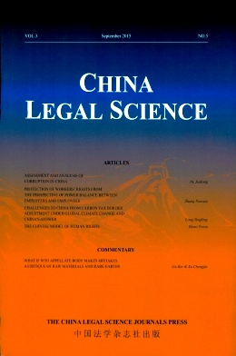
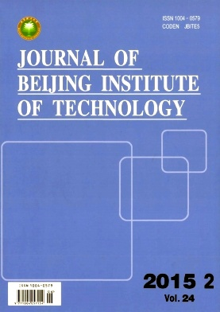
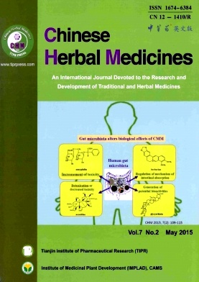
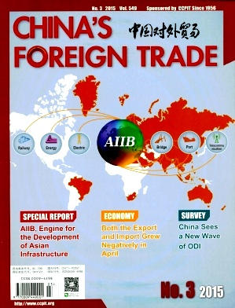
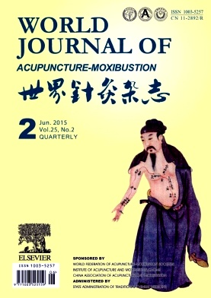
Integrated and Comprehensive Resource
Journals
Full-text in English;
198 titles with 313 thousand articles;
Year Coverage: 1935-2015
Proceedings
Full-text in English;
2317 Proceedings with 273 thousand articles;
Year Coverage: 1985-2015

Slide 7
Resource Distribution by Series:
Journals | 专辑 Series | 期刊种数 Titles | 文献量 Articles Count（K）
科技与医药 Science,Technolgoy and Medicine | 基础科学 Basic Sciences | 59 | 98.3
 | 工程技术I（冶金、材料和化工） Engineering and Technology I | 22 | 65.7
 | 工程科技II （工业技术和工程） Engineering and Technology II | 23 | 51.2
 | 农业 Agriculture | 18 | 27.7
 | 医药卫生 Medicine/Hygiene | 35 | 59.7
 | 电子与信息科学 Electronics and Information Science | 12 | 23.8
人文与社会科学 Humanities and Social Science | 文学/历史/哲学 Literature/History/philosophy | 9 | 23.9
 | 政治/军事/法律 Politics/Military/Law | 9 | 31.3
 | 教育与社会学 Education and Sociology | 3 | 13.3
 | 经济与管理 Economy and Management | 11 | 45
Proceedings | 专辑 Series | 期刊种数 Titles | 文献量 Articles Count（K）
科技与医药 Science,Technolgoy and Medicine | 基础科学 Basic Sciences | 403 | 41.8
 | 工程技术I（冶金、材料和化工） Engineering and Technology I | 357 | 40.8
 | 工程科技II （工业技术和工程） Engineering and Technology II | 397 | 46.9
 | 农业 Agriculture | 111 | 16
 | 医药卫生 Medicine/Hygiene | 146 | 24.9
 | 电子与信息科学 Electronics and Information Science | 625 | 92.6
人文与社会科学 Humanities and Social Science | 文学/历史/哲学 Literature/History/philosophy | 45 | 1.9
 | 政治/军事/法律 Politics/Military/Law | 20 | 3.7
 | 教育与社会学 Education and Sociology | 83 | 12.7
 | 经济与管理 Economy and Management | 191 | 16.6

Slide 8
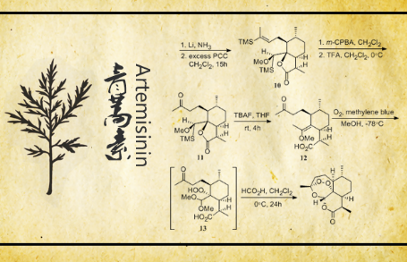
Free Articles Recommendation
Academic hot topics
Latest publication from China's English Journals
Free Online-reading of recommended articles
Solar Cells
Artemisinin
Cancer

Slide 9
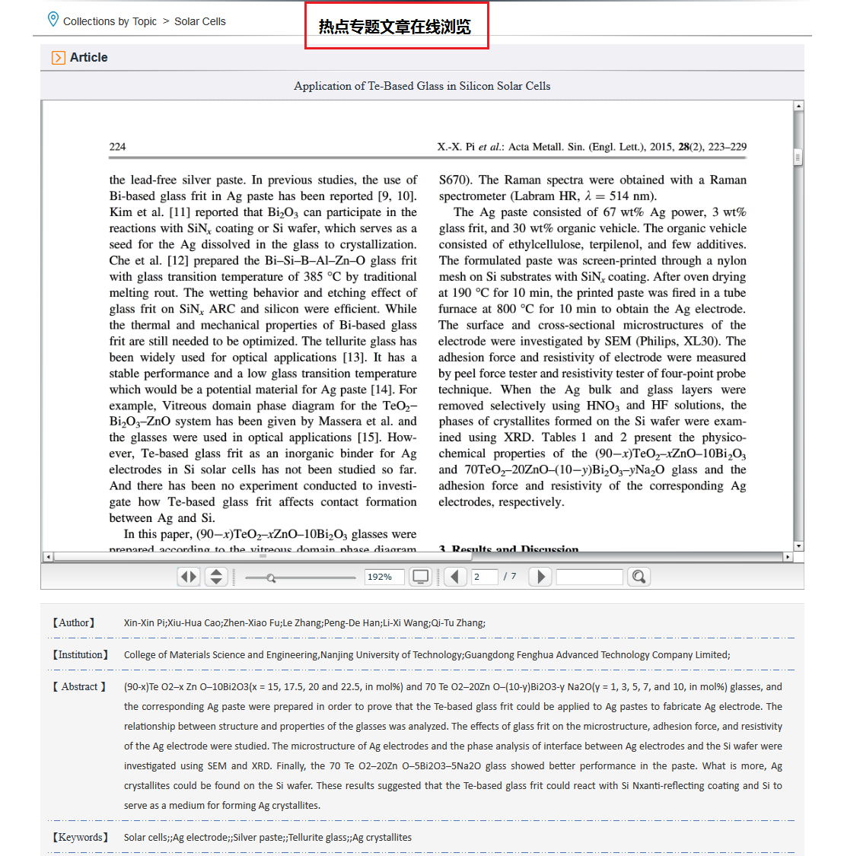
Professional Edition & Composing
(for the free online reading part)

Slide 10
Main Functions
Retrieval
Journals/ Proceedings Navigation
My Account
CNKI Knowledge Node

Slide 11
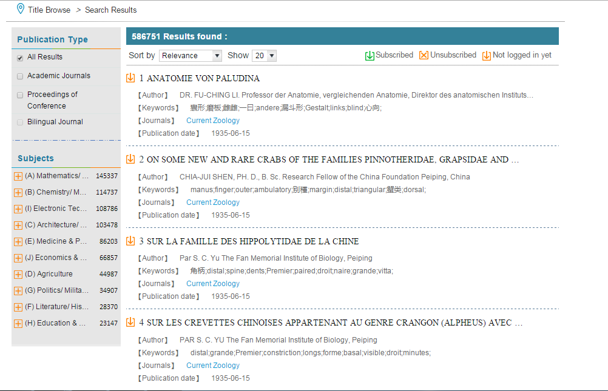
Retrieval: One-stop Search
Search by Document Type
Search by Subject
Sort the results by relevance/ Publication Date
Download directly

Slide 12
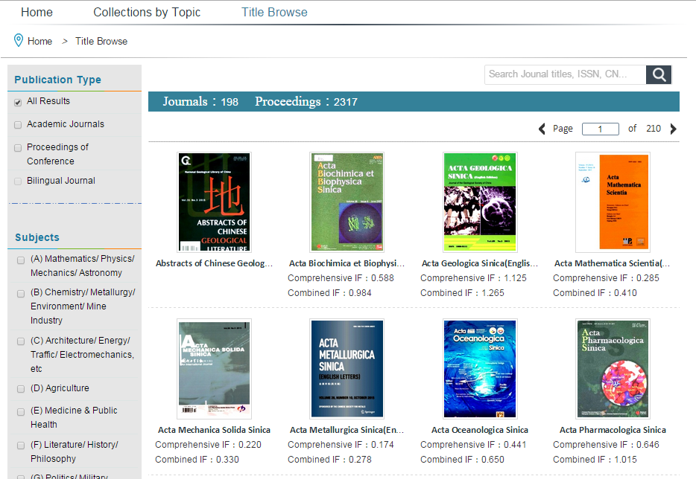
Journals/ Proceedings Navigation
Finding a journal/ Proceeding
Choose Publication Type
Choose under a special Subject

Slide 13
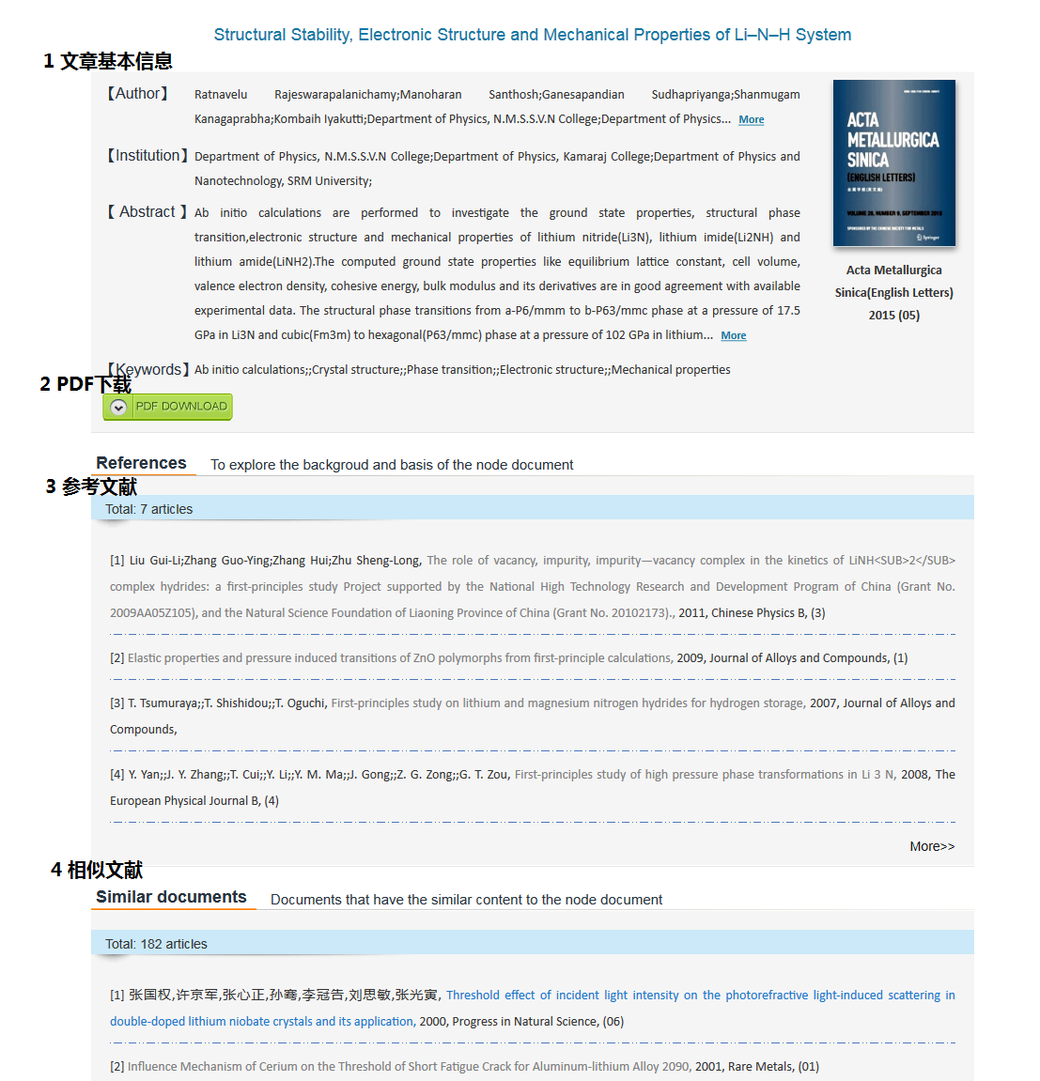
CNKI Knowledge Node
Author, Institution, Abstract, Keywords
Reference
Similar Articles
Live Link to connect other CNKI articles

Slide 14
Service Mode
Journals
1. Annual subscription (all journals collection)
2. Subscribing by Series
3. Subscribing to single journals
Proceedings
1. Annual subscription (all proceedings collection)

Slide 15
Thank you！
http://cstm.cnki.net/

